Slide 1

BENGAL COLLEGE OF ENGINEERING
Submitted by:
Priyanshu Jha
Nandalal Gorai
Mayank Singh
Kunal Kr. Roy
Mentor:
Mr. Biplab Mahapatra
Asst. Professor (CSE)

Slide 2
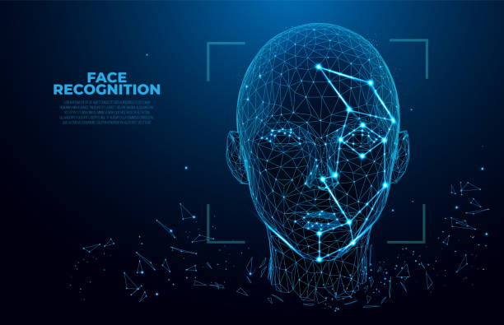

Advance Face Recognition Attendance System using

Slide 3
Outline :
1. Introduction
2.Tools Used
3.Significance
4. Functional Block Diagram
5. Conclusion

Slide 4


Introduction :
Traditionally attendance is marked manually by teachers and they must make sure correct attendance is marked for respective student.
This whole process wastes some of lecture time and part of correct information is missed du.

Slide 5
1.Python
2.Tkinter
3.OpenCV
4.MySql
TOOLS USED :

Slide 6
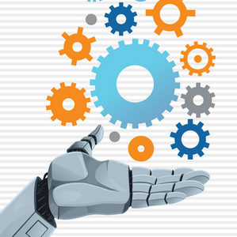

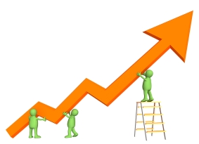
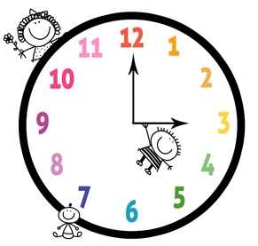
Significance:
1-Automated
2- Economically
3-Effective
4- Keep extra time

Slide 7
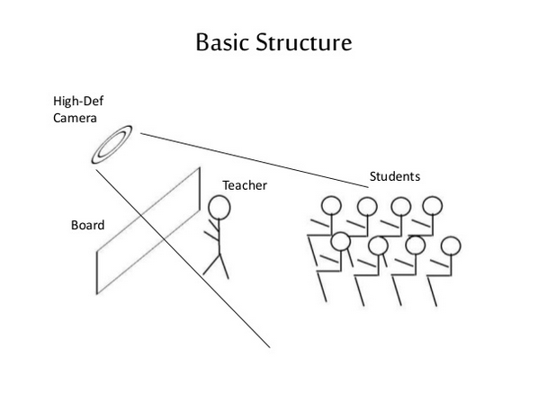

Slide 8
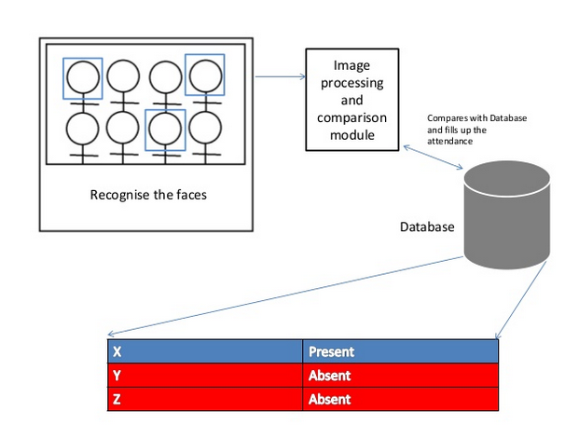

Slide 9
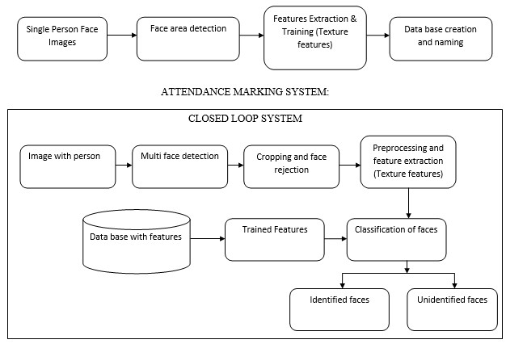
Functional Block Diagram:
The whole system should consist of

Slide 10
Face Detection:
Face detection is a computer technology used to identify human faces in digital images by determining the location of the faces in the image and extract sub images for each face.
Viola-Jones and LBPH algorithm will be implemented to recognize face and non-face patterns and enable us to identify locations of the faces in the image.

Slide 11
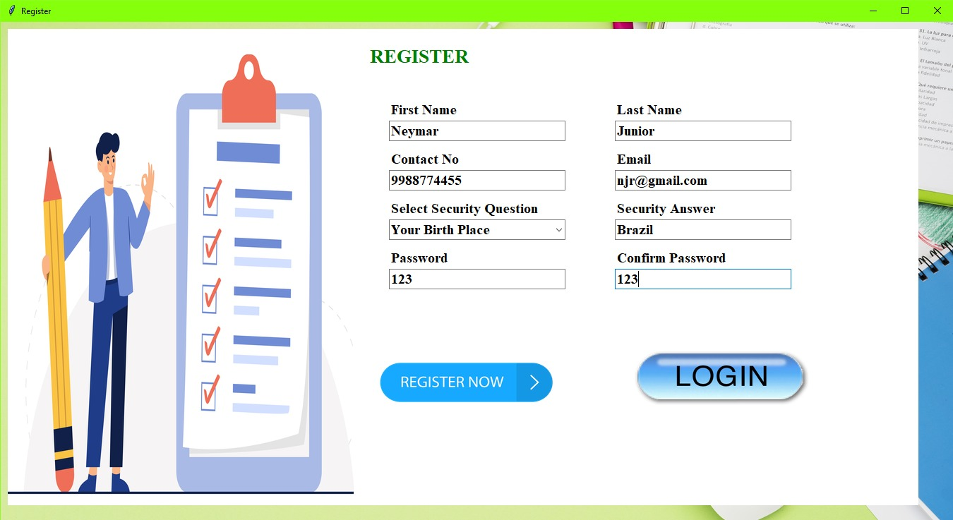
Register Page

Slide 12
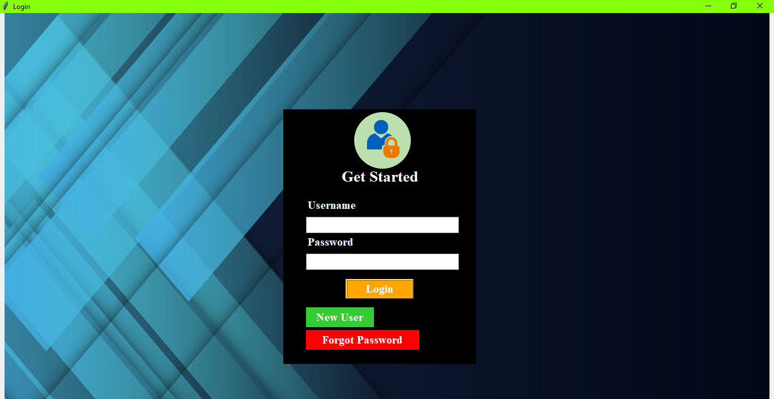
Login Page

Slide 13
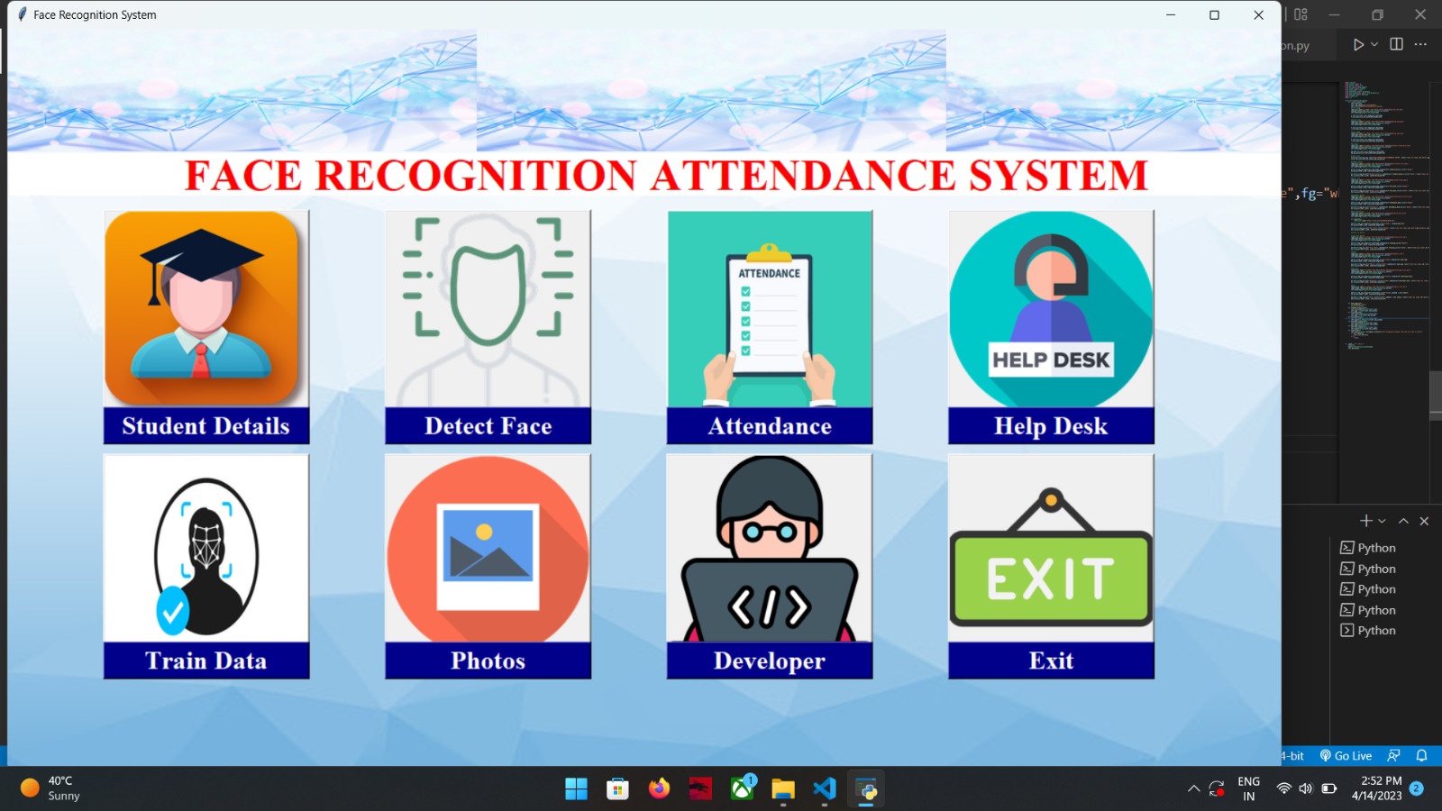
Dashboard

Slide 14
Records:-
Our Records basically is the collection of face images and extracted features. And the record also includes names of students & and other details .

Slide 15
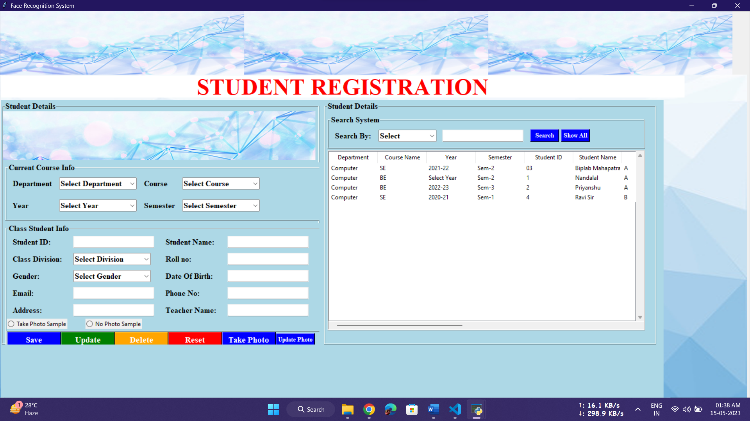

Slide 16
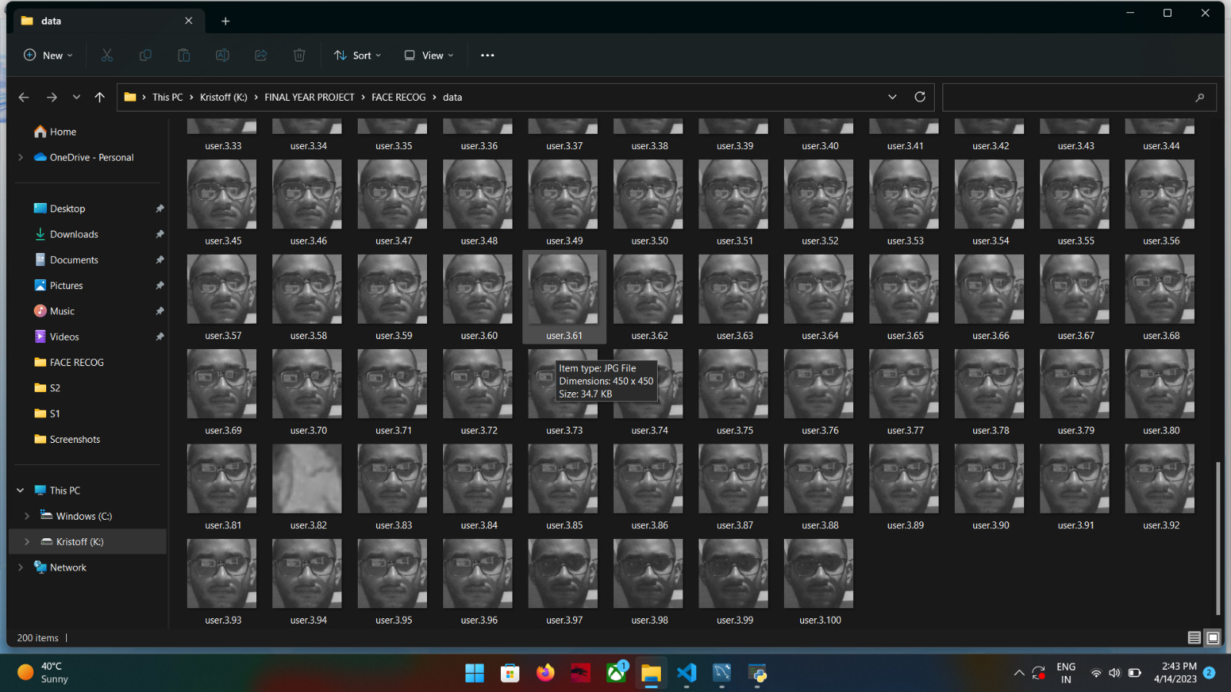
Example for data base images:

Slide 17
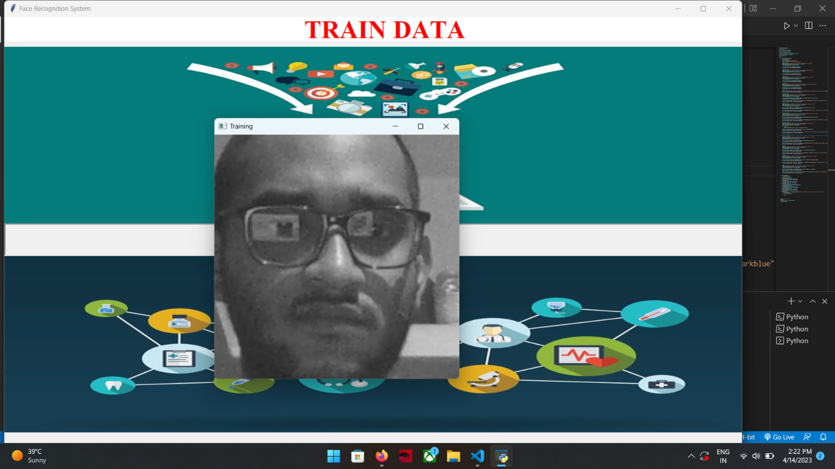
Train data

Slide 18
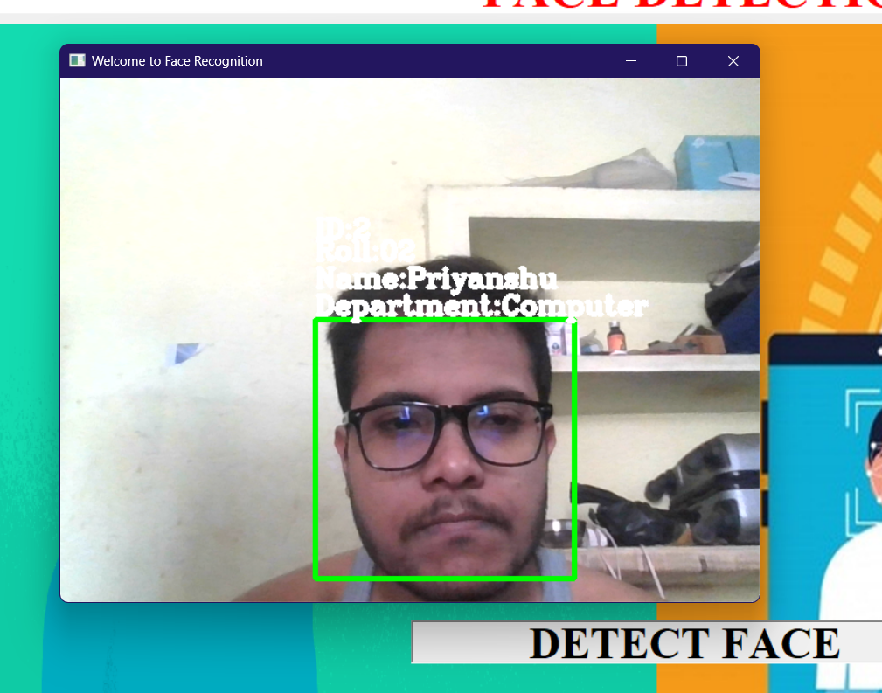
Face Detection Final Result

Slide 19
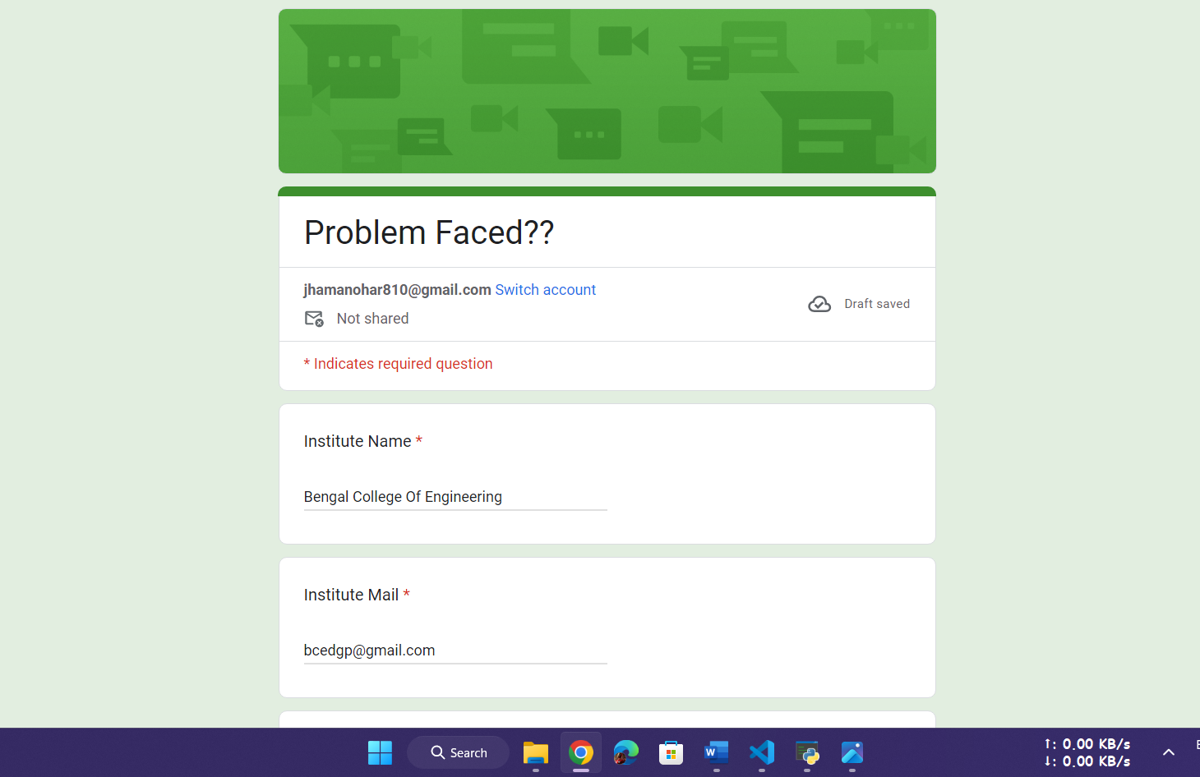
Help desk

Slide 20
FUTURE WORK
UI Improvement
Software Optimization
AI Improvement

Slide 21
Conclusion:
From our experiment, we noticed the face recognition was sensitive to face background, light, and head orientations. This technique described the accurate and efficient method of automatic attendance in the classroom which could replace the traditional method. An automatic attendance has many advantages, most of the existing systems are time consuming and require semi manual interference from lecturers, our system seeks to solve these issues by using face recognition in the process to save the time and labor. And No need for installing complex hardware for taking the attendance in classroom, all we need is a camera and laptop. We used algorithms that can detect and recognize faces in the image.

Slide 22


